Slide 1

Airlines Use Cases

Slide 2
. Crew Pairing Approach & Data Element
We can solve this crew paring problem by using classification & optimal assignment .
Data element : Crew data, Route data, fleet data, Flight schedule data, Revenue per route, Air leg data, Duty period, Rest period or time, Work time, daily data, weekly data, monthly data, Monthly schedule, weekly schedule, City of origin and of destination , Aircraft type, Duration of flight
We will create crew pair properties, time, cost, Past experience for route, Past working time
First we will classify crew based upon Past experience & revenue
Then we will use optimization assignment to assign each crew pair the work

Slide 3
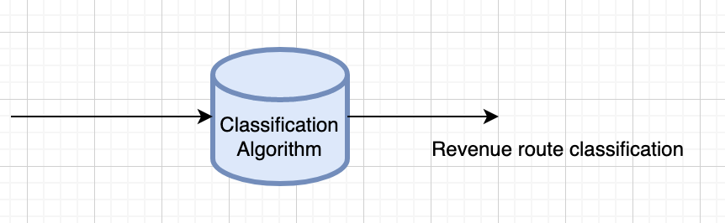
User pairing properties
User- user | Past time | Route worked | Route data | Duration worked |  |  | ……..
A-B (P1)
A-C (P2)
B-C (P3)
We can visualize user – user past time, past route info
Visualize specific route revenue
Visualize user- route time
Based upon we will first use Classification Machine learning algorithm to classify route revenue(Probability)

Slide 4
Optimization Technique
input
Algorithm
output

Slide 5
Thank You

